Slide 1

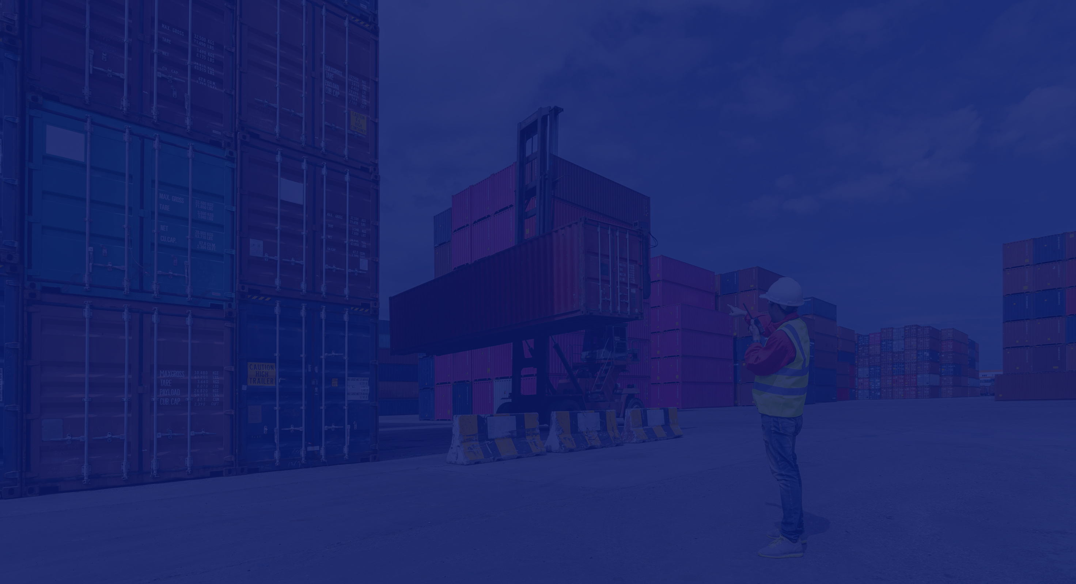



FLEETFLOAT
SHIPPING SUPPORT SYSTEM PROPOSAL

Slide 2


ABOUT US
Hillary Kimaiga: project lead, Backend Developer
Deborah Wanjiku: Database engineer
Bramwel Shaw: Backend Developer
Yvonne Kwaya: UI/UX & Frontend Developer
Sharon Nyaboke: Finance module developer
Josphat mwaura: Data analysis & QA Engineer

Slide 3
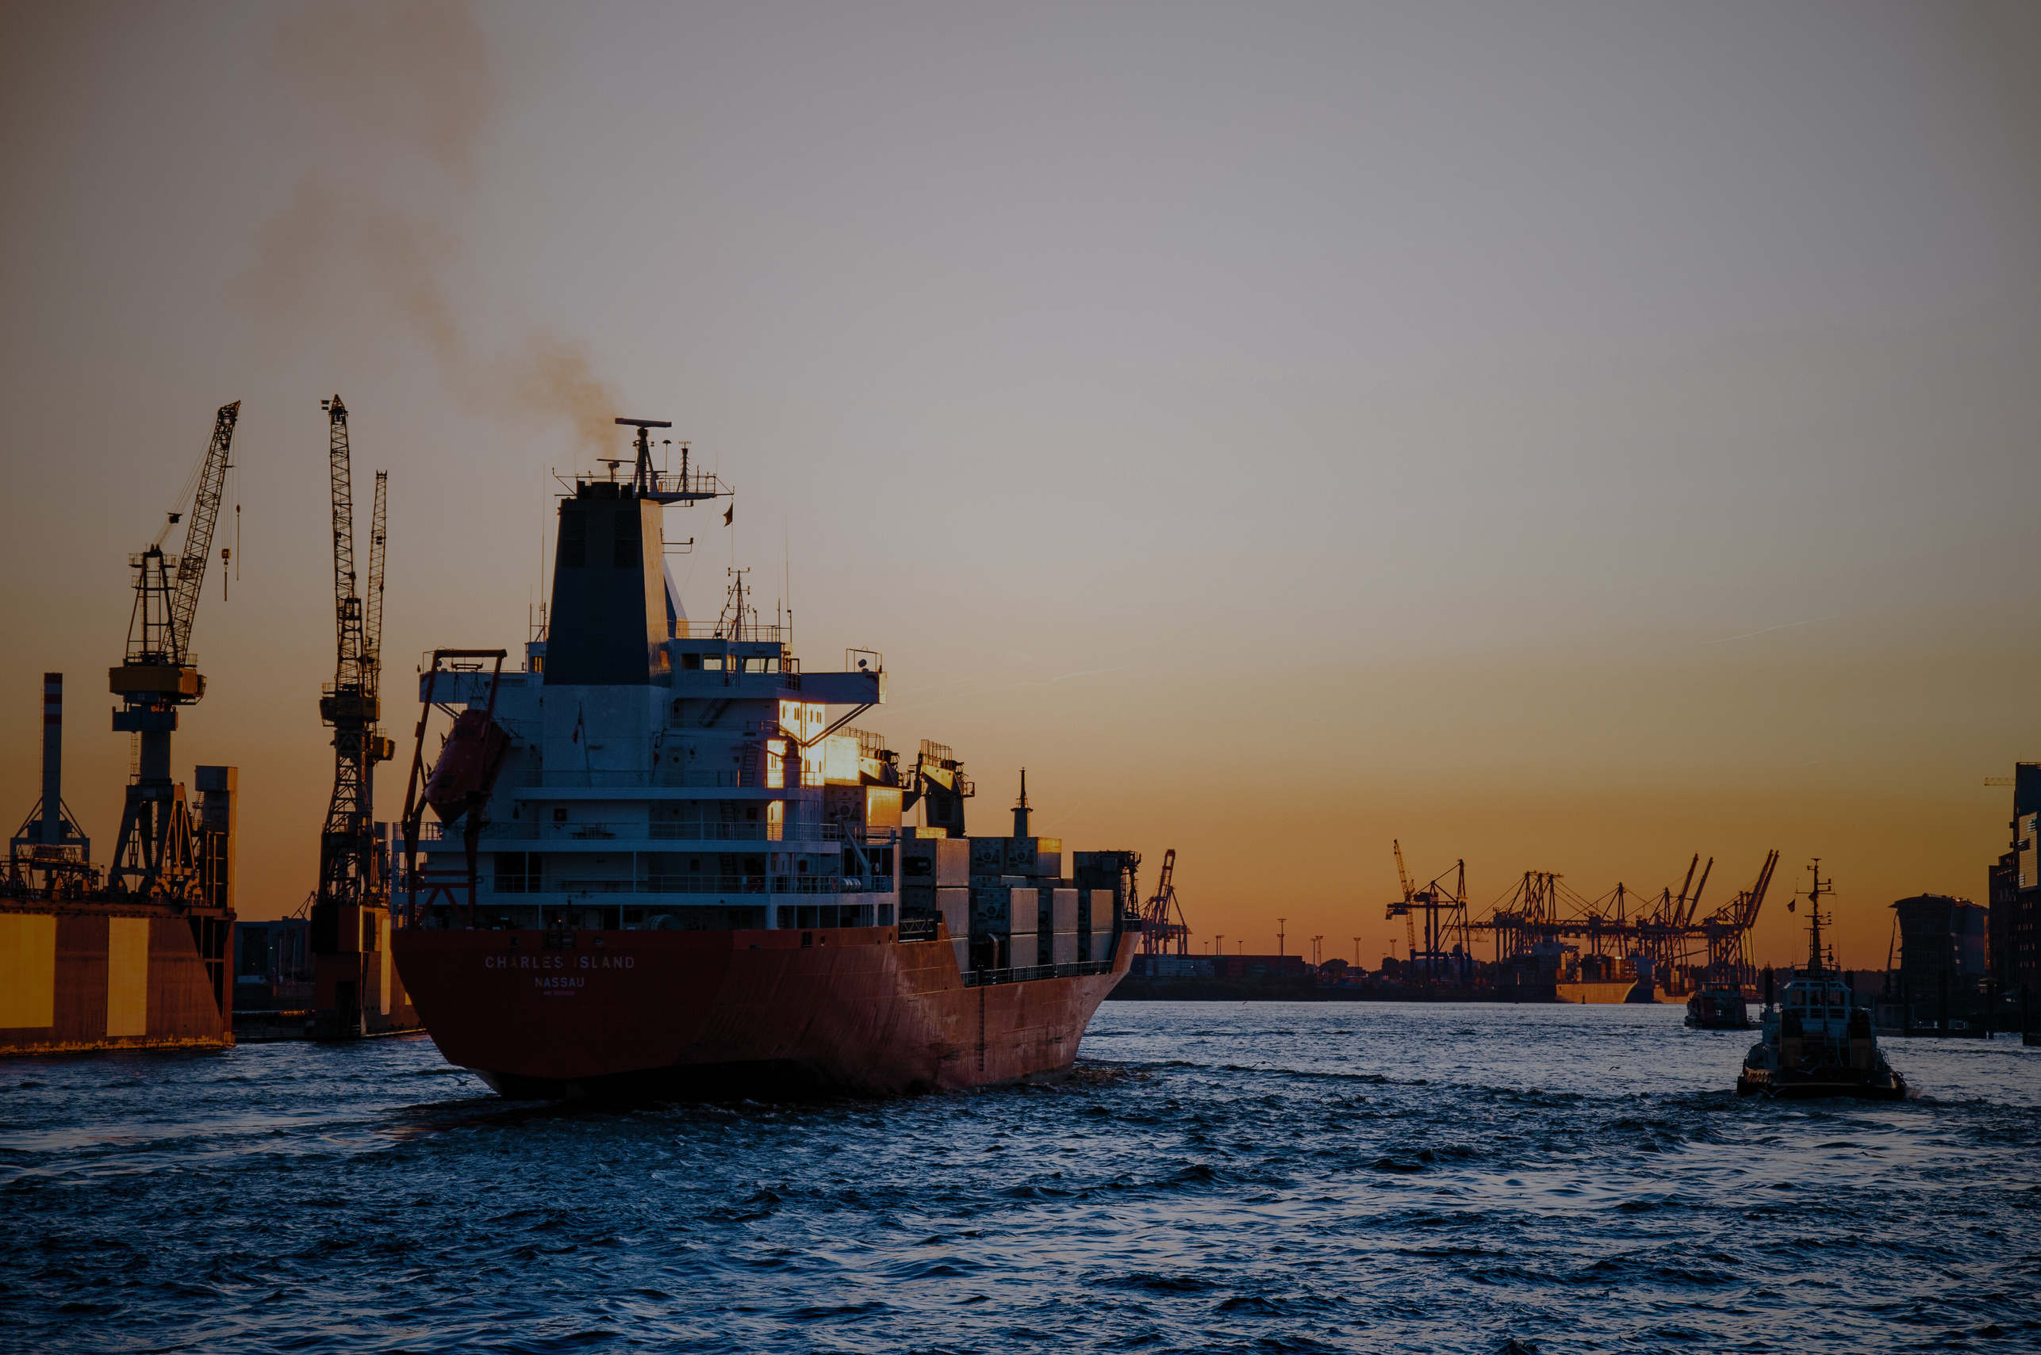
PROJECT CONCEPT
The Shipping Support System is a comprehensive platform designed to manage and streamline the operations of a shipping and logistics network. It integrates various aspects such as ship management, cargo handling, port docking, storage, land transport, personnel management, financial transactions, and tracking services.
This system ensures efficient logistics by enabling seamless coordination between shipping companies, transport providers, port authorities, and cargo owners.

Slide 4
PROBLEMS STATEMENT
Lack of real-time tracking, leading to lost or misplaced shipments.
Inefficient warehouse storage, causing increased costs and congestion.
Limited integration between sea and land transport, creating bottlenecks in logistics.
Without a centralized and automated system, these inefficiencies lead to higher operational costs, shipment delays, and reduced customer satisfaction.

Slide 5
OUR OBJECTIVE
Automate ship docking, cargo tracking, and transport logistics
Improve real-time tracking of cargo and transportation
Reduce operational delays and optimize warehouse storage
Streamline financial transactions for invoicing and payments

Slide 6

APP FEATURES
Ship & Cargo Management
Ship Management: Stores details such as ship name, capacity, registration, ownership, and status.
Container & Cargo Handling: Records information about shipping containers, their TEU capacity, cargo type, weight, and assigned ships.
Cargo Ownership: Maintains records of cargo owners and their shipments.

Slide 7
Docking & Storage
Port & Dock Management: Tracks port capacity, available docks, and ship docking schedules.
Warehouse Storage: Manages storage spaces, cargo duration, and warehouse capacity.
Transportation (Land & Sea)
Train Transport: Assigns cargo to trains, records schedules, and monitors train movement.
Lorry Transport: Tracks lorry availability, driver assignments, and road transport schedules.

Slide 8
Personnel & Workforce Management
Ship Crew Management: Stores crew details, ranks, and assigned ships.
Dock Workers & Operators: Manages shift schedules, work experience, and assigned ports.
Drivers: Tracks driver licenses, assigned vehicles, and work history.
Ownership & Business Relations
TEU Owners & Cargo Clients: Stores details of individuals or companies owning shipping containers and transported goods.
Shipping & Transport Companies: Maintains records of businesses providing shipping and land transport services.

Slide 9
Financial & Billing
Port & Storage Fees: Calculates charges for ship docking and warehouse storage.
Transportation Fees: Bills for train and lorry transportation services.
Invoices & Payments: Keeps records of generated invoices, payments made, and outstanding balances.
Logs & Tracking
Cargo Tracking: Uses tracking numbers to monitor cargo locations and statuses.
Ship Schedules: Maintains ship arrival and departure records for efficient port scheduling.
Incident Reports: Logs accidents, delays, or security breaches affecting cargo or ships.

Slide 10

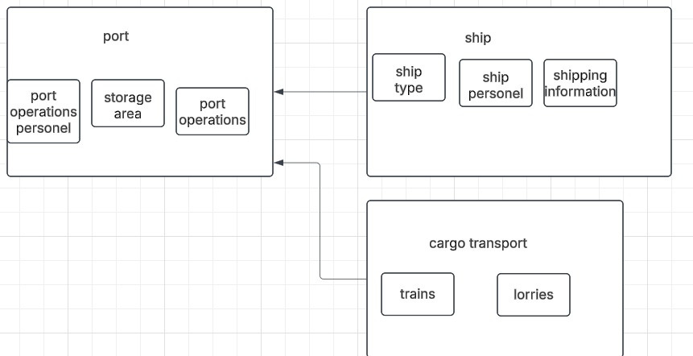
SYSTEM ARCHITECTURE

Slide 11
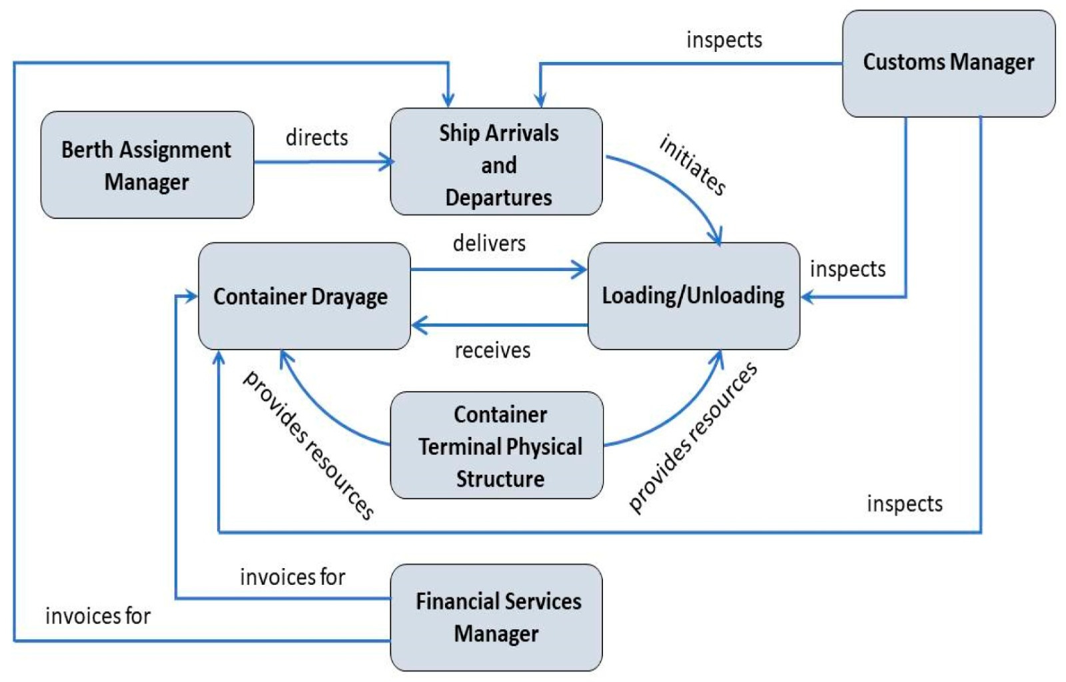

Slide 12
OUR CLIENT
Mareven Food Central LLC,
Mareven Food Central LLC, which was established in 1999 in Russia, is a subsidiary of the international group Mareven Food Holdings Ltd. They are specialized in the production and distribution of food and beverages. They supply their products to 85 constituent entities of the Russian Federation and seven countries around the world. Some of their products are energy drinks, chips, noodles, ready-made meals, and dairy products.

Slide 13




UTOSCOPE
CONTACT US
+254 717 091187
kimaiga.hillary@gmail.com
Juja, Kiambu Kenya

Slide 14
FLEETFLOAT
THANK YOU FOR YOUR ATTENTION
EXPLORE NOW

